Slide 1

UCR HONORS PROGRAM
Chirag Kulkarni
Gemma Raymundo
Joshua Ortega
Stella Aurelia
Victoria Nguyen

Slide 2
Agenda
Introduction of Study
Description of Data
Objective
Descriptive Analysis
Tables
Visualizations
Statistical Method
Chi-Square Test
Cramer’s V
Application
Data Analysis
Conclusion

Slide 3
Introduction of Study
The UCR Honors Program is a program designed to help students network with faculty, staff, and other students and have opportunities for research and internships.
These communities of students consist of a variety of majors, admitted cohort years, and other variables.
Towards the end of the program students are expected to complete a capstone project.

Slide 4
Description of Data
The data presented is an aggregate of different factors that UCR committee kept in mind when considering accepting students into their honors program. The types of data include both categorical and numerical, providing a well-rounded image of the type of student that UCR is looking for in a prospective honors student.

Slide 5
Objective
The objective of the study is to create a profile on potentially successful students in order to understand what type of student groups perform the best and to be able to market the program towards those students.

Slide 6
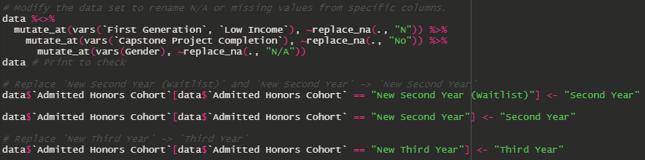
Data Cleaning
Modify data by renaming values from these columns:
First Generation
Low Income
Capstone Completion
Gender
Admitted Honors Cohort

Slide 7
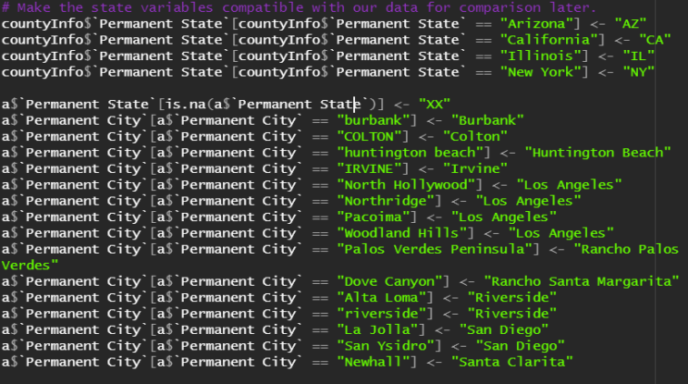
Data Cleaning
If student’s permanent state is not California, assign Permanent Region and Permanent County column to say “others”

Slide 8
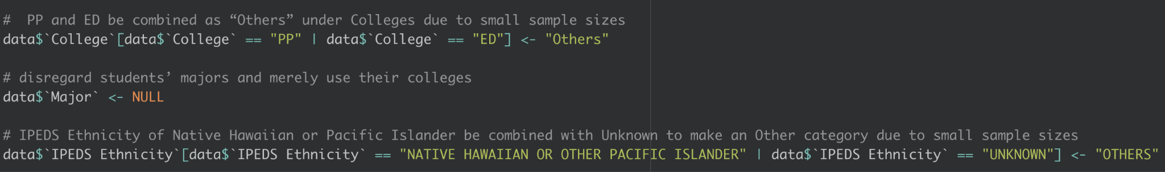
Data Cleaning
Because the School of Public Policy and School of Education had so few Honors students, they were combined into “Others”. Similarly, we did the same for the Unknown and Native Hawaiian or Pacific Islander IPEDS Ethnicities.
The variable Major was also removed completely, as a majority of majors had very small sample sizes.

Slide 9
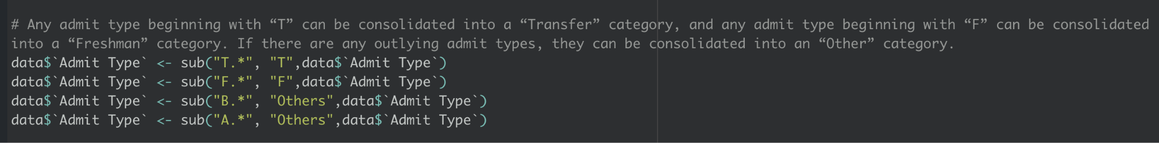
Data Cleaning
We further consolidated Admit Type into 3 categories: Freshmen, Transfer, and Other.

Slide 10
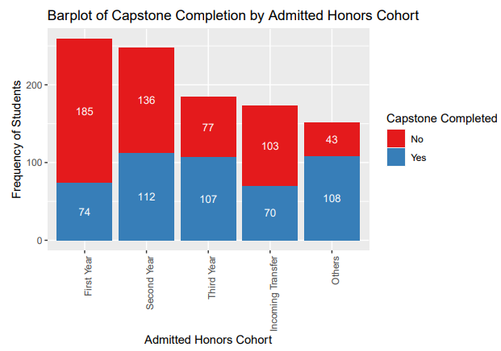
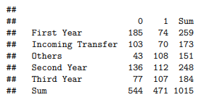
Descriptive Analysis

Slide 11
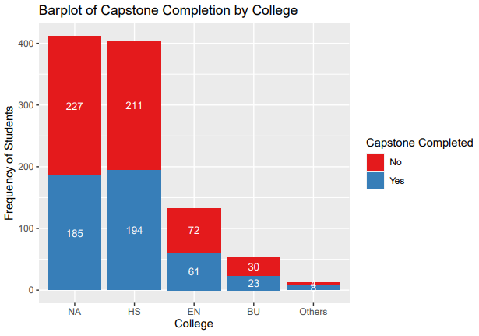
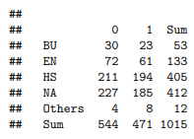
Descriptive Analysis

Slide 12
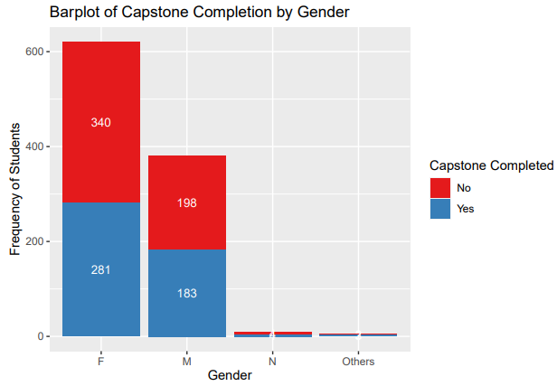
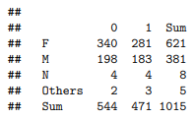
Descriptive Analysis

Slide 13
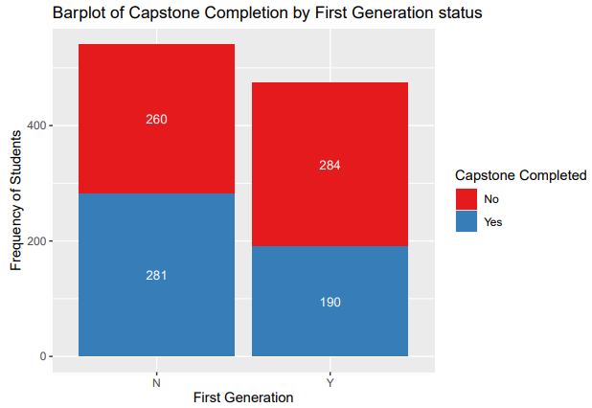

Descriptive Analysis

Slide 14
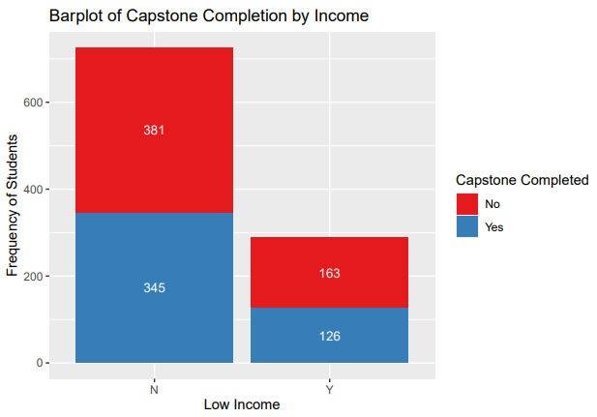

Descriptive Analysis

Slide 15
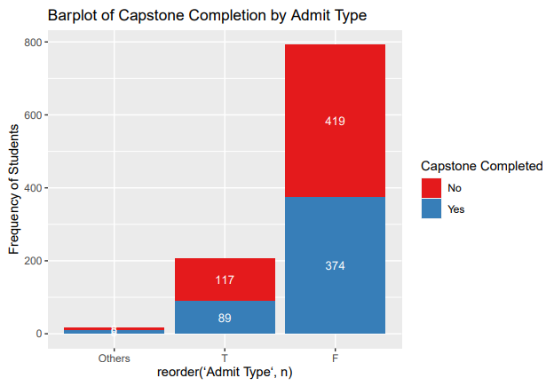
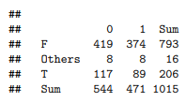
Descriptive Analysis

Slide 16
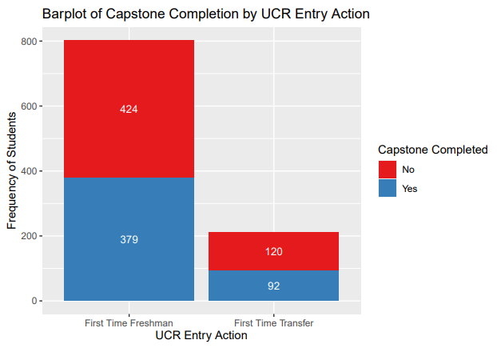

Descriptive Analysis

Slide 17
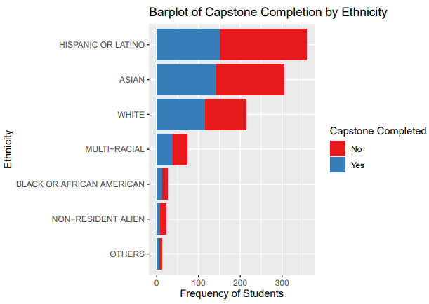
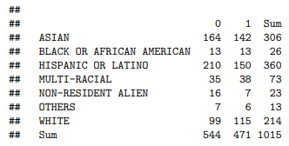
Descriptive Analysis

Slide 18
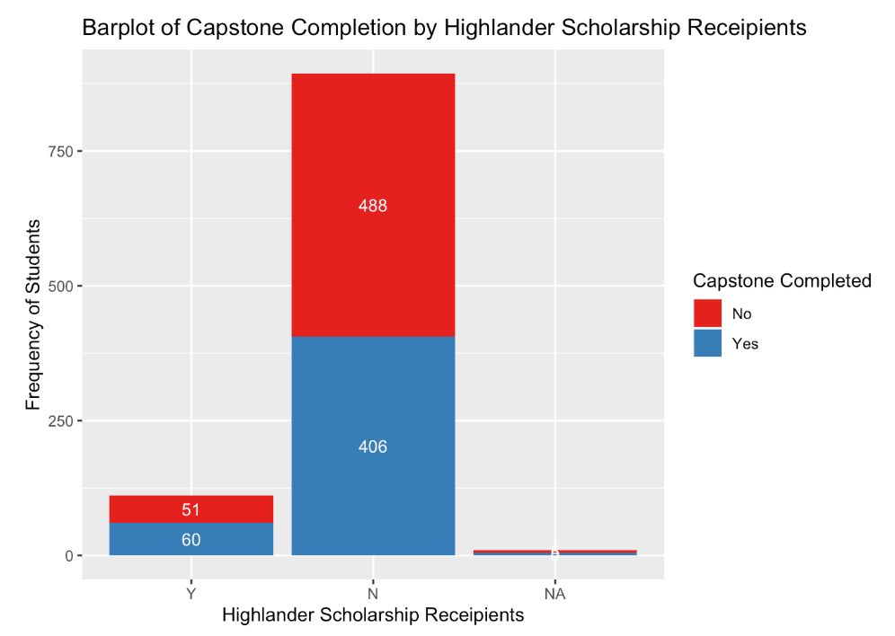
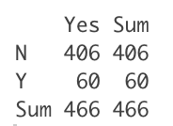
Descriptive Analysis

Slide 19
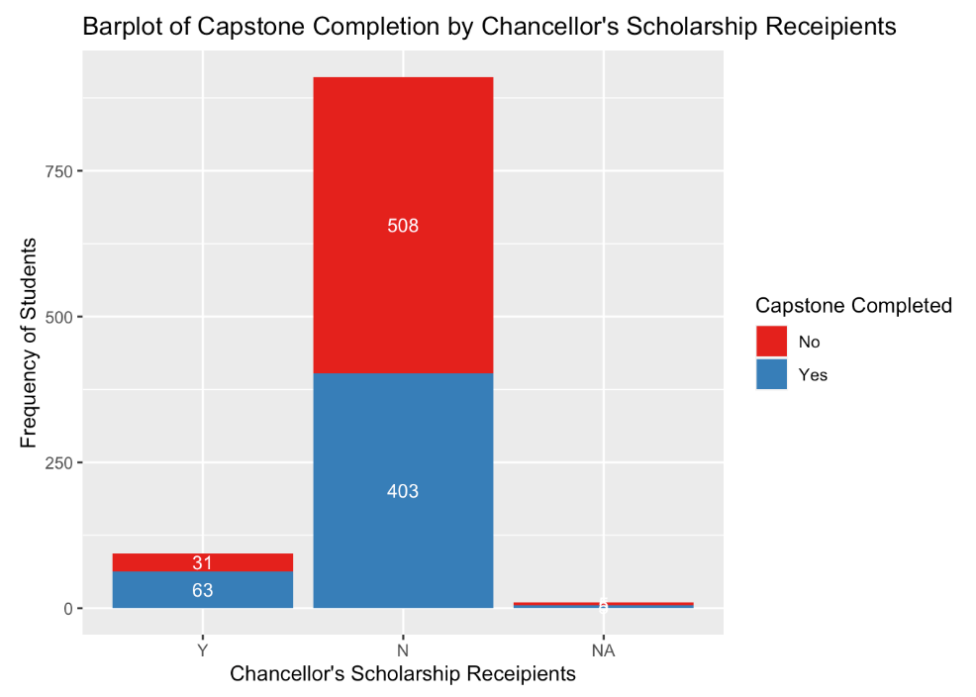
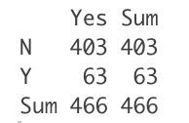
Descriptive Analysis

Slide 20
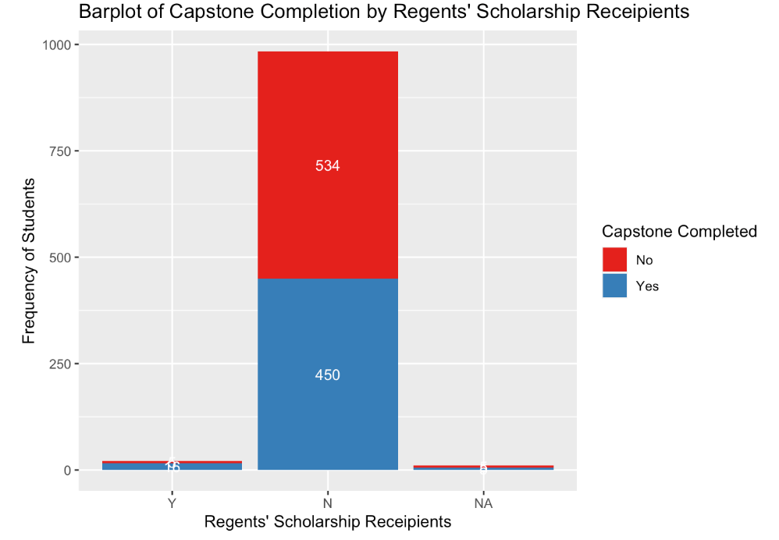
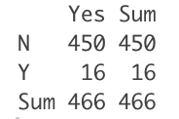
Descriptive Analysis

Slide 21

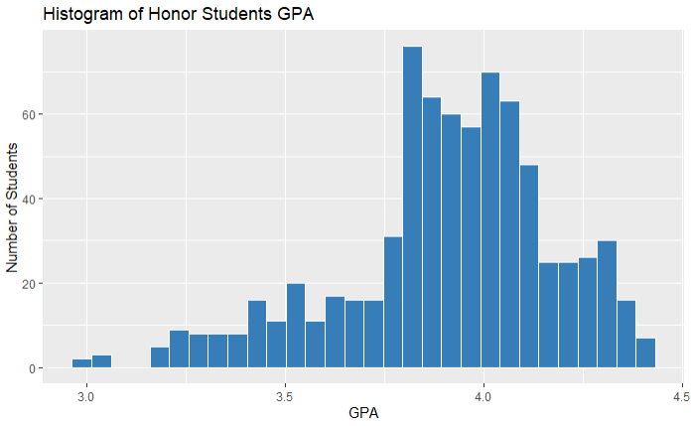
Descriptive Analysis

Slide 22
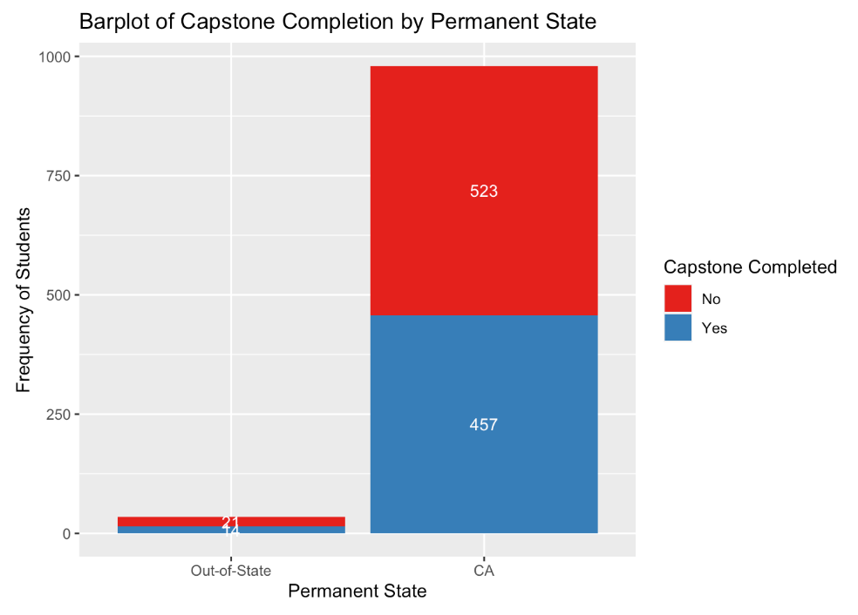
Descriptive Analysis

Slide 23
Proposed Statistical Methods
We decided to use two statistical methods: Chi-Square Test and Cramer’s V to find if there was a dependent relationship between the categorical variables of interest and “Capstone Completion”. If it was determined to be a dependent relationship, we would then move on to using Cramer’s V to determine the strength of these relationships.
Any variables where Cramer’s V was insignificant or weak were omitted from the presentation.

Slide 24
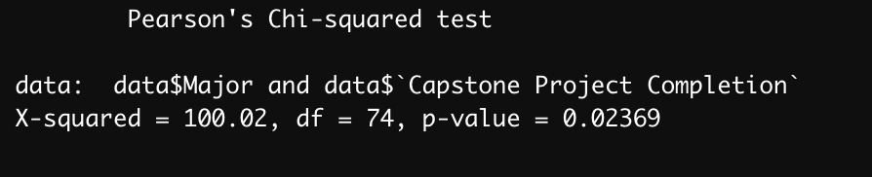
Chi-Square Test
Major vs Capstone Project Completion
H0: there is no relationship between Major and Capstone Completion
Ha: there is a relationship between Major and Capstone Completion
RR: Reject H0 if if p-value < α = 0.05
Conclusion: Since p-value = 0.02369 < α = 0.05, we reject H0 and conclude that there is a relationship between the students' majors and the Capstone Completion.

Slide 25
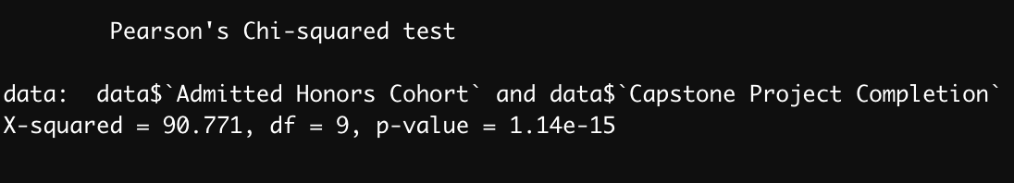
Chi-Square Test
Admitted Honors Cohort vs Capstone Project Completion
H0: there is no relationship between Admitted Honors Cohort and Capstone Completion
Ha: there is a relationship between Admitted Honors Cohort and Capstone Completion
RR: Reject H0 if if p-value < α = 0.05
Conclusion: Since p-value < α = 0.05, we reject H0 and conclude that there is a relationship between the students' Admitted Cohort and Capstone Completion.

Slide 26
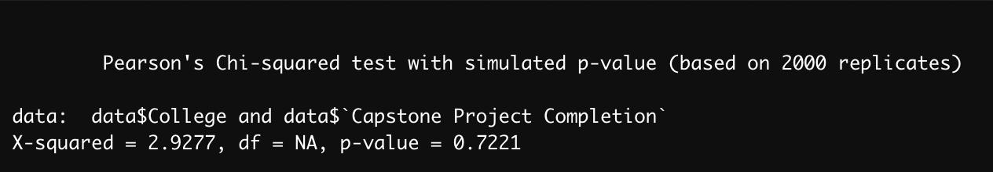
Chi-Square Test
College vs Capstone Project Completion
H0: there is no relationship between College and Capstone Completion
Ha: there is a relationship between College and Capstone Completion
RR: Reject H0 if if p-value < α = 0.05
Conclusion: Since p-value = 0.7221 > α = 0.05, we fail to reject H0 and conclude that there is no relationship between the students' college and their Capstone Completion.

Slide 27
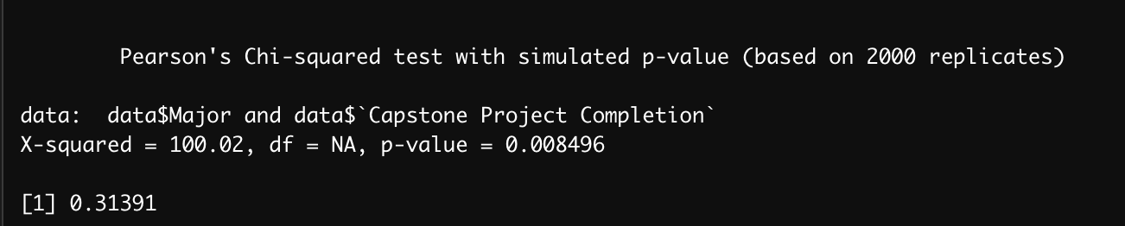
Cramer’s V
Major vs Capstone Project Completion
H0: there is no relationship between Major and Capstone Completion
Ha: there is a relationship between Major and Capstone Completion
RR: Reject H0 if if p-value < α = 0.05
Conclusion: Since p-value = 0.008496 < α = 0.05, we reject H0 and conclude that there is a relationship between the students' majors and the Capstone Completion.
In addition, since our Cramer's V is > 0.2, we conclude a moderate relationship between Major and Capstone Completion

Slide 28
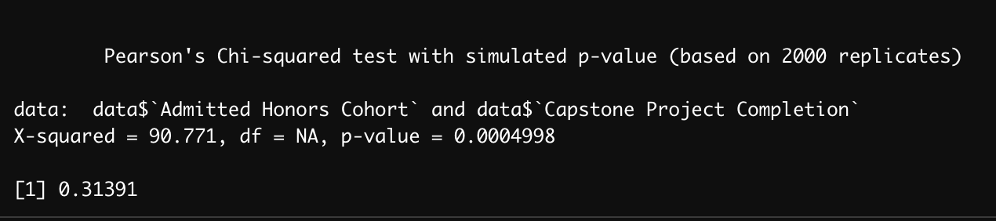
Cramer’s V
Admitted Honors Cohort vs Capstone Project Completion
H0: there is no relationship between Major and Capstone Completion
Ha: there is a relationship between Major and Capstone Completion
RR: Reject H0 if if p-value < α = 0.05
Conclusion: Since p-value = 0.0004998 < α = 0.05, we reject H0 and conclude that there is a relationship between the Admitted Honors Cohort and the Capstone Completion.
In addition, since our Cramer's V is > 0.2, we conclude a moderate relationship between Admitted Honors Cohort and Capstone Completion

Slide 29
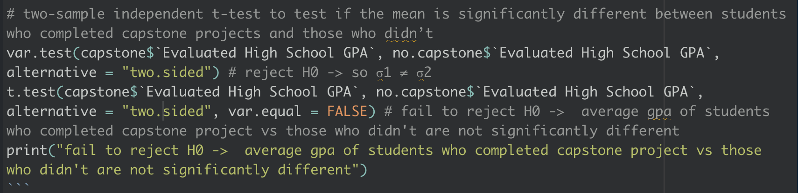
Two Sample T-Test
Using the following code for a two-sample independent t-test, we found that only these variables were significant:
First Generation
Admitted Honors Cohort
Chancellor’s Scholarship
Regents’ Scholarship
Permanent County

Slide 30
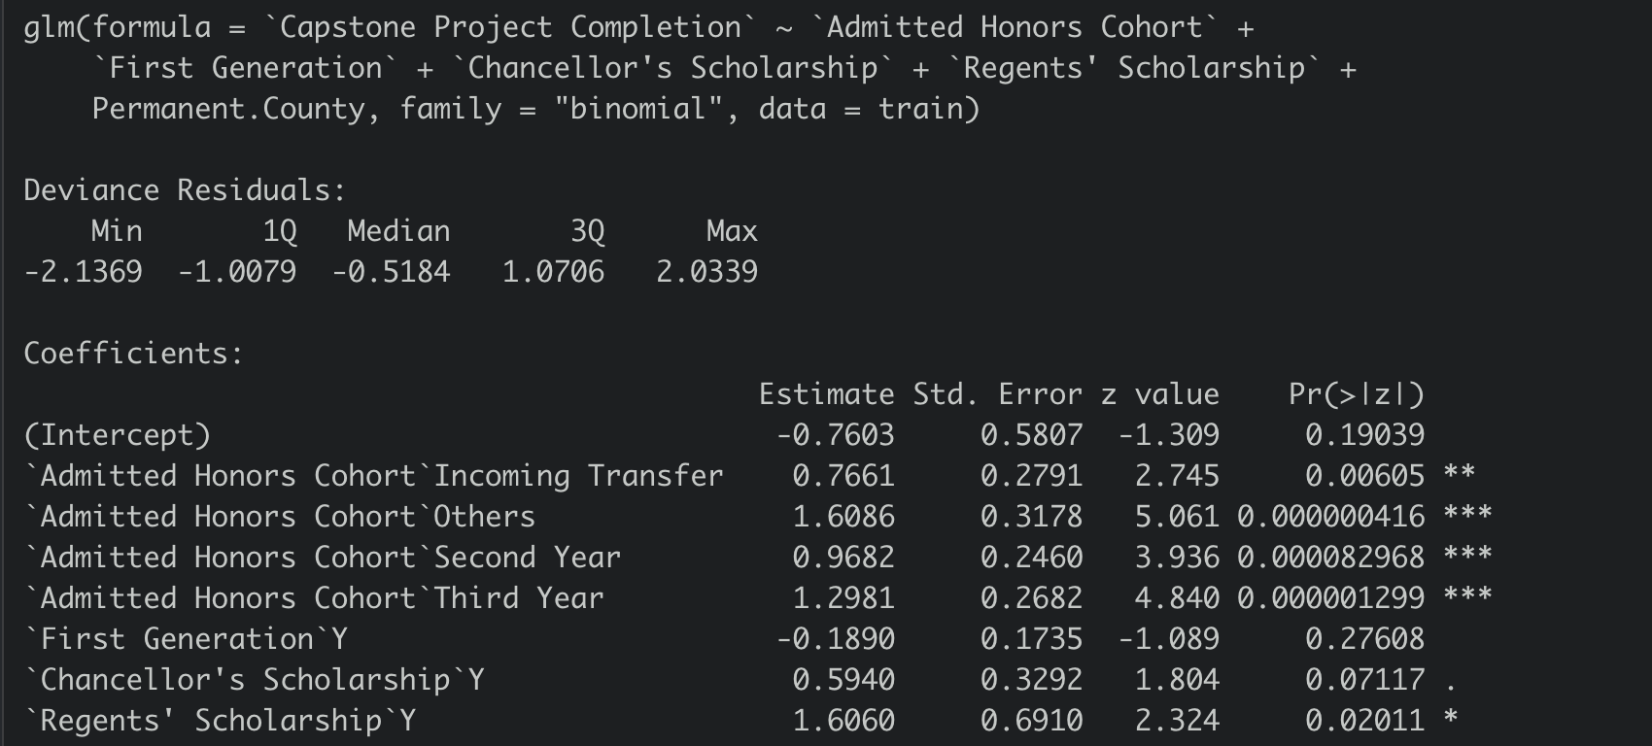
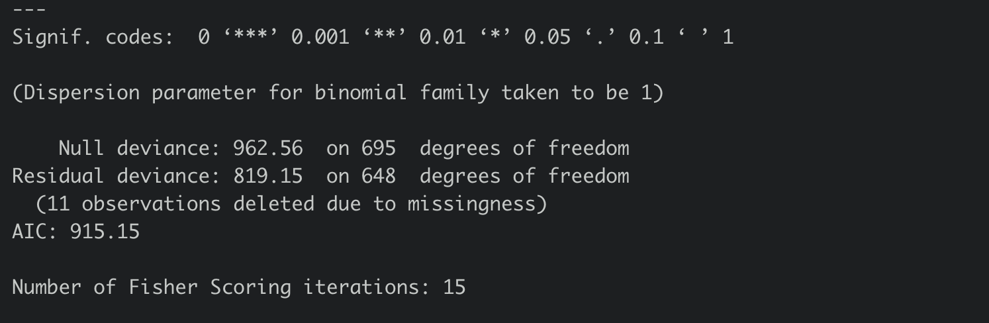
Logistic Regression Model

Slide 31
Significant Variables
From Chi-Squared tests and Two Sample t-Test:
Admitted Honors Cohort
First Generation
Chancellor’s Scholarship
Regents’ Scholarship
Permanent County
From Linear Regression model (P-values < α = 0.05):
Admitted Honors Cohort
Regents’ Scholarship
From Linear Regression model (P-values < α = 0.10):
Admitted Honors Cohort
Chancellor’s Scholarship
Regents’ Scholarship
County

Slide 32
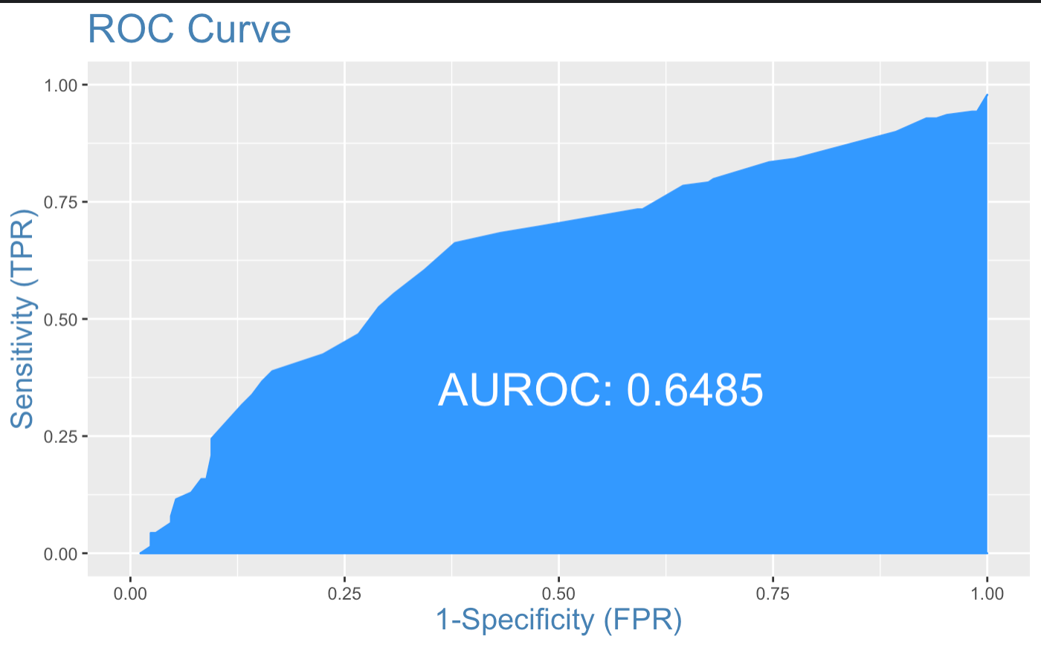
Logistic Regression Model - ROC Curve
The linear regression model did not reveal any variables that we had not already found significant before through Chi-Square testing
In addition, we used an ROC curve and found that the model was only 65% accurate.

Slide 33
Can all variables be applied?
IPEDS Ethnicity vs Capstone Project Completion
Gender vs Capstone Project Completion
UCR Entry Action vs Capstone Project Completion
H0: there is no relationship with Capstone Completion
Ha: there is a relationship with Capstone Completion
RR: Reject H0 if if p-value < α = 0.05
In each test between these variables and Capstone Project Completion, we fail to reject the null hypothesis and conclude independence and thus we don’t conduct any further test using Cramer’s V.

Slide 34
Data Analysis
From the previous tests, we know we have a dependent relationship with moderate association with Capstone Project Completion to Admitted Honors Cohort, First Generation, Chancellor’s Scholarship, Regents’ Scholarship and Permanent County. Since we know these variables have some dependent relationship with our variable of interest, Capstone Completion, we plug them into our regression model.
Unfortunately, the biggest issue with our resulting regression model was the fact that, even with all of these dependent variables being taken into account, the model isn’t incredibly accurate, at about 65%. Since our accuracy, even after numerous attempts to improve it, isn’t the greatest, we felt it would be reckless to include in the presentation in its current state.

Slide 35
Conclusion
From our data analysis, we found there is a dependent relationship between Admitted Honors Cohort, First Generation, Chancellor’s Scholarship, Regents’ Scholarship, and Permanent County.
Upon further investigation using Cramer’s V, we can infer that the strength of these relationships is at the very least close to moderate.

